Slide 1

For Loop in Python

Slide 2
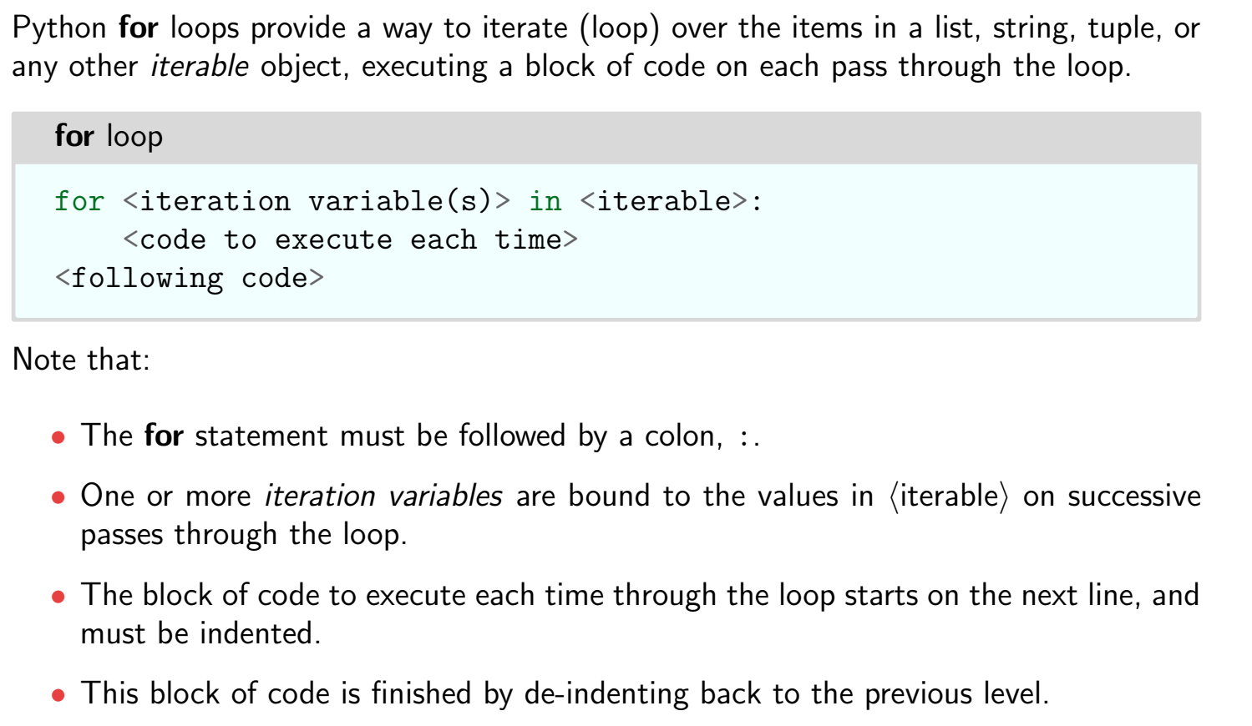
For loop

Slide 3

Accessing list using for loop

Slide 4

Accessing string using for loop

Slide 5

Enumerate with for loop

Slide 6

Range function

Slide 7

Example

Slide 8

Example

Slide 9

Example

Slide 10

Example

Slide 11

Example

Slide 12

Example

Slide 13
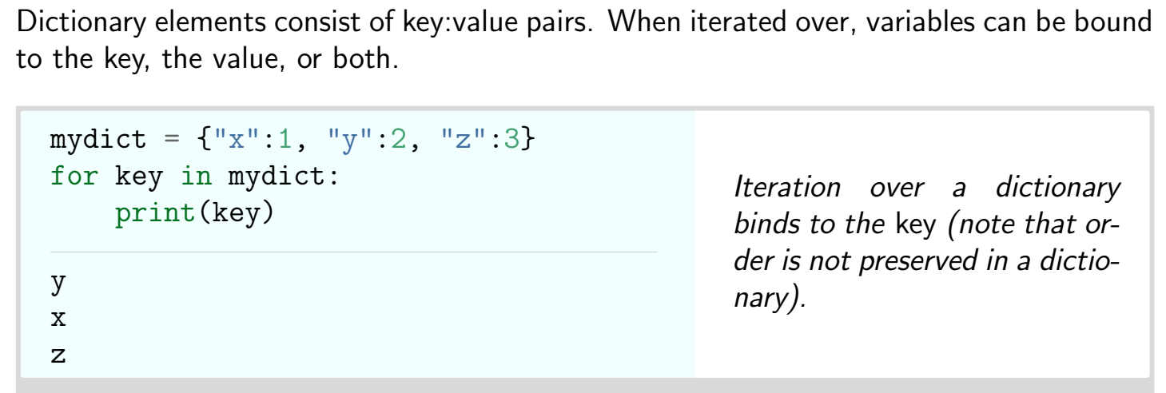
Accessing Dictionary using For Loop

Slide 14

Example

Slide 15

Example

Slide 16

Parallel access

Slide 17

Using for loop

Slide 18
Thank You

